Slide 1
Linear Algebra

Slide 2

Rizqi Okta Ekoputris
Machine Learning Scientist at Nodeflux
Alumni of Institut Teknologi Sepuluh Nopember (ITS) 13’

Slide 3
Why we should learn Linear Algebra?

Slide 4

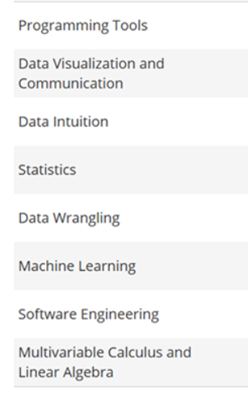
https://blog.udacity.com/2014/11/data-science-job-skills.html

Slide 5
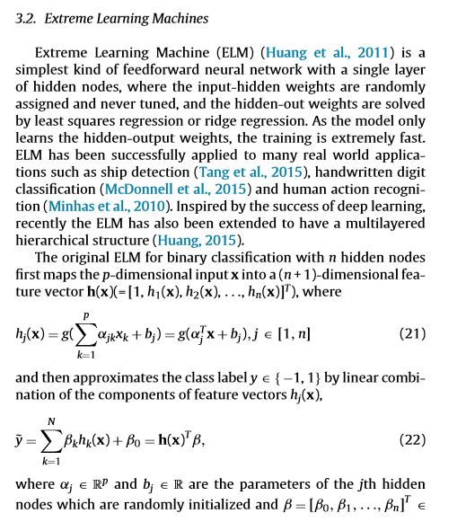
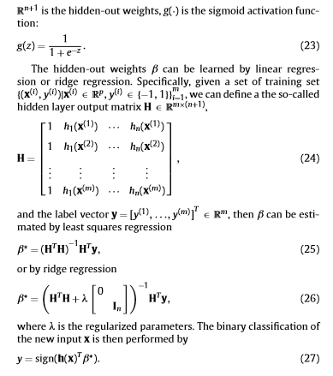

Slide 6

What will we learn?
Fundamental Linear Algebra
Intro Matrices
Intro Vectors
Linear Transformation
Euclidean n-spaces

Slide 7
Fundamental Linear Algebra
Notes:
Consider talking about:
ATLAS

Slide 8

What is linear algebra?
Learning of Algebra in Linear
$$y=2x$$
$$x+2y+3z=0$$
$$a+3b+5c+9d=6e$$
$$xy=0$$
$$y=\sin\left(x\right)$$
$$e=mc^{2}$$
$$a^{n}=b$$
$$n=\log_{b}{c}$$

Slide 9

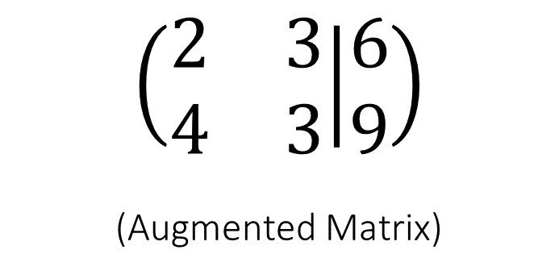
$2x+3y=6$
$4x+3y=9$
$$\left(\begin{matrix}2 & 3 \\ 4 & 3\end{matrix} | \begin{matrix}6 \\ 9\end{matrix}\right)$$
(Augmented Matrix)
Notes:
The Equation can be represented as Augmented matrix. What should we do using this AM?

Slide 10


Operasi Baris Elementer - OBE Elementary Row Operation - ERO
There are 3 operation rules:
Multiply a row through by a nonzero constant (real, scalar)
$$\left(\begin{matrix}2 & 3 \\ 4 & 3\end{matrix} | \begin{matrix}6 \\ 9\end{matrix}\right)$$
$$\left(\begin{matrix}1 & 1.5 \\ 4 & 3\end{matrix} | \begin{matrix}3 \\ 9\end{matrix}\right)$$
Row1 * ½

Slide 11


Operasi Baris Elementer - OBE Elementary Row Operation - ERO
There are 3 operation rules:
Multiply a row through by a nonzero constant (real, scalar)
Interchange two rows
$$\left(\begin{matrix}2 & 3 \\ 4 & 3\end{matrix} | \begin{matrix}6 \\ 9\end{matrix}\right)$$
$$\left(\begin{matrix}4 & 3 \\ 2 & 3\end{matrix} | \begin{matrix}9 \\ 6\end{matrix}\right)$$
Interchange Row1 and Row2

Slide 12


Operasi Baris Elementer - OBE Elementary Row Operation - ERO
There are 3 operation rules:
Multiply a row through by a nonzero constant (real, scalar)
Interchange two rows
Add a multiple of one row to another row
$$\left(\begin{matrix}2 & 3 \\ 4 & 3\end{matrix} | \begin{matrix}6 \\ 9\end{matrix}\right)$$
Row2 = 2*Row1 – Row2
$$\left(\begin{matrix}2 & 3 \\ 0 & 3\end{matrix} | \begin{matrix}6 \\ 3\end{matrix}\right)$$
Notes:
Why we should use ERO?

Slide 13
Row Echelon Form – REF
If a row does not consist entirely of zeros, then the first nonzero number in the row is a 1 (we call this a leading one).
If there are any row that consist entirely of zeros, then they are grouped together at the bottom of the matrix.
If any two successive rows that do not consist entirely of zeros, the leading one in the lower row occurs farther to the right than the leading one in the higher row.

Slide 14
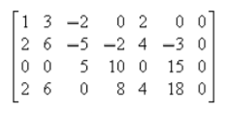


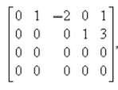





Row Echelon Form – REF
If a row does not consist entirely of zeros, then the first nonzero number in the row is a 1 (we call this a leading one).
If there are any row that consist entirely of zeros, then they are grouped together at the bottom of the matrix.
If any two successive rows that do not consist entirely of zeros, the leading one in the lower row occurs farther to the right than the leading one in the higher row.

Slide 15
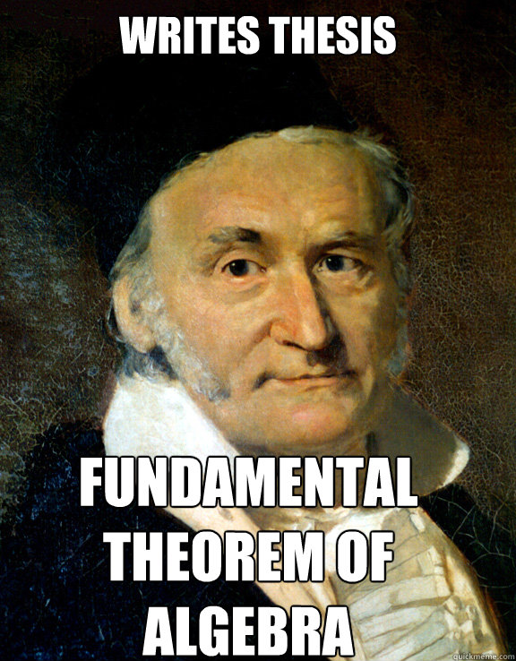
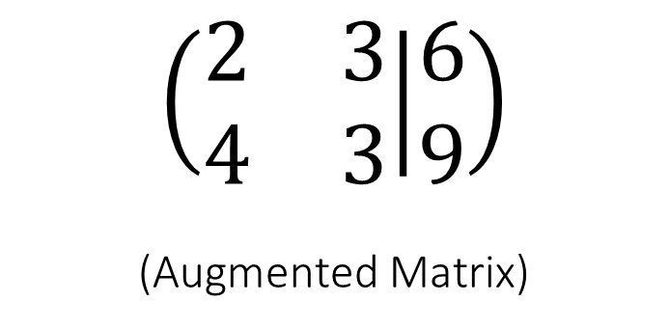
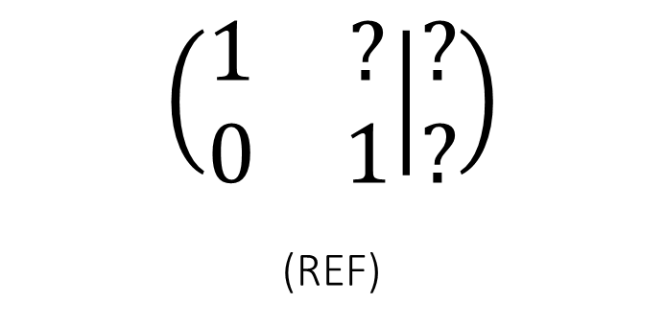
$$\left(\begin{matrix}2 & 3 \\ 4 & 3\end{matrix} | \begin{matrix}6 \\ 9\end{matrix}\right)$$
(Augmented Matrix)
$$\left(\begin{matrix}1 & ? \\ 0 & 1\end{matrix} | \begin{matrix}? \\ ?\end{matrix}\right)$$
(REF)
Gaussian Elimination

Slide 16
Reduced Row Echelon Form – RREF
If a row does not consist entirely of zeros, then the first nonzero number in the row is a 1 (we call this a leading one).
If there are any row that consist entirely of zeros, then they are grouped together at the bottom of the matrix.
If any two successive rows that do not consist entirely of zeros, the leading one in the lower row occurs farther to the right than the leading one in the higher row.
Each column that contains a leading one has zeros everywhere else (above and below)

Slide 17
Reduced Row Echelon Form – RREF
If a row does not consist entirely of zeros, then the first nonzero number in the row is a 1 (we call this a leading one).
If there are any row that consist entirely of zeros, then they are grouped together at the bottom of the matrix.
If any two successive rows that do not consist entirely of zeros, the leading one in the lower row occurs farther to the right than the leading one in the higher row.
Each column that contains a leading one has zeros everywhere else (above and below)

Slide 18
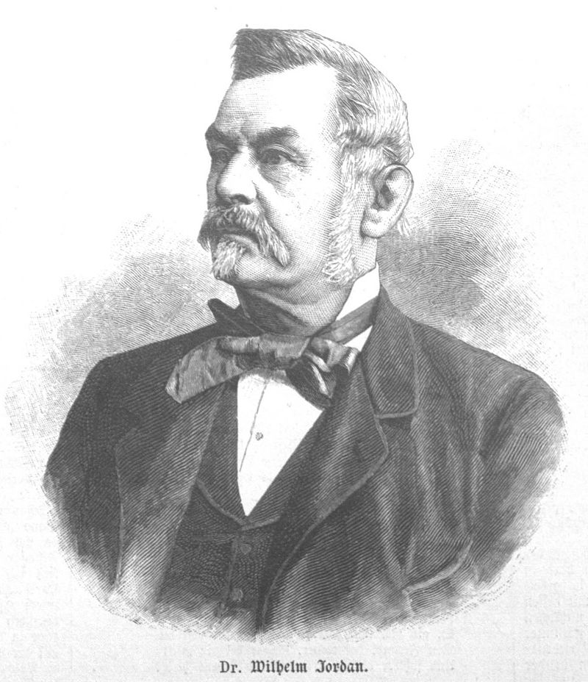

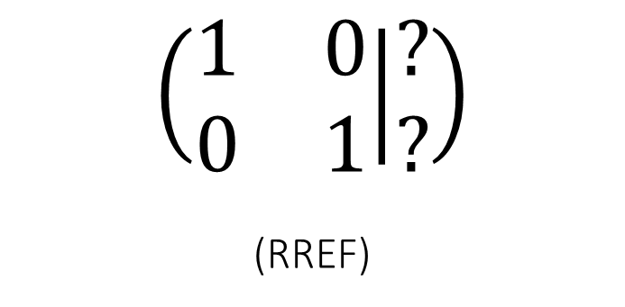
$$\left(\begin{matrix}2 & 3 \\ 4 & 3\end{matrix} | \begin{matrix}6 \\ 9\end{matrix}\right)$$
(Augmented Matrix)
$$\left(\begin{matrix}1 & 0 \\ 0 & 1\end{matrix} | \begin{matrix}? \\ ?\end{matrix}\right)$$
(RREF)
Gauss-Jordan Elimination

Slide 19


$$\left(\begin{matrix}0 & 1 & 2 \\ 3 & 1 & 2 \\ 6 & 2 & 1\end{matrix} | \begin{matrix}8 \\ 11 \\ 13\end{matrix}\right)$$
$$\left(\begin{matrix}1 & 2 & 3 \\ 2 & 4 & 6 \\ 2 & 3 & 4\end{matrix} | \begin{matrix}6 \\ 12 \\ 9\end{matrix}\right)$$

Slide 20

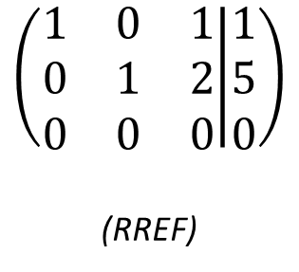
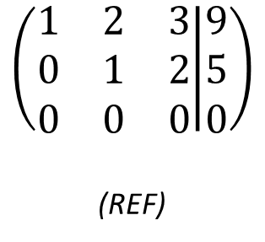
$$\left(\begin{matrix}1 & 2 & 3 \\ 2 & 4 & 6 \\ 2 & 3 & 4\end{matrix} | \begin{matrix}9 \\ 18 \\ 13\end{matrix}\right)$$
(AM)
$$\left(\begin{matrix}1 & 2 & 3 \\ 0 & 1 & 2 \\ 0 & 0 & 0\end{matrix} | \begin{matrix}9 \\ 5 \\ 0\end{matrix}\right)$$
(REF)
$$\left(\begin{matrix}1 & 0 & 1 \\ 0 & 1 & 2 \\ 0 & 0 & 0\end{matrix} | \begin{matrix}1 \\ 5 \\ 0\end{matrix}\right)$$
(RREF)

Slide 21
Homogeneous Linear System :
In a homogeneous linear system the constant terms are all zeros.
a₁₁x₁ + a₁₂x₂ + a₁₃x₃ + ……….. + a_{1n}x_{n} = 0
a₂₁x₁ + a₂₂x₂ + a₂₃x₃ + ……….. + a_{2n}x_{n} = 0
………………
a_{m1}x₁ + a_{m2}x₂ + a_{m3}x₃ + ……….. +a_{mn}x_{n} = 0
Solution:
Trivial (x_{i} = 0; i = 1, 2, 3, .. n ) → All variables must independent
Non-trivial (infinitely many solutions , plus the trivial solution) → At least one variable is dependent

Slide 22



Slide 23
Intro Matrices
Notes:
Consider talking about:
Level 1
Level 2
Level 3

Slide 24
What will we learn?
Matrix Operations
Special Matrices
Determinant
Inverse Matrix

Slide 25
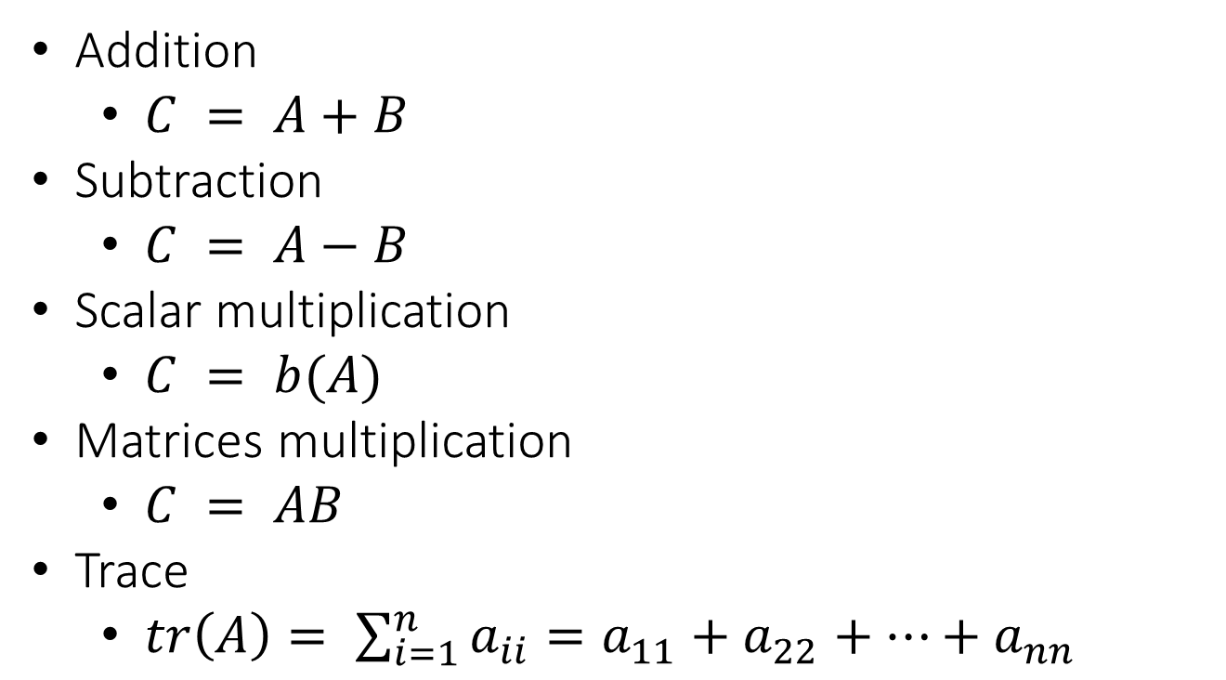
Matrix Operations
Addition
$C = A+B$
Subtraction
$C = A−B$
Scalar multiplication
$C = b(A)$
Matrices multiplication
$C = AB$
Trace
$tr\left(A\right)= \sum_{i=1}^{n}{a_{ii}=a_{11}+a_{22}+…+a_{nn}}$

Slide 26

Special Matrices
Transpose
$T=A^{T}$
Diagonal matrix
$D: a_{ij} = 0 for i ≠ j$
Upper triangular matrix
${U: a}_{ij} = 0 for i > j$
Lower triangular matrix
$L: a_{ij} = 0 for i < j$
Symmetric matrix
$S: a_{ij} = a_{ji}$
Cofactor matrix
Adjoint matrix
$J ={adj\left(A\right)= C}^{T}$

Slide 27
Matrix of cofactors:
C₁₁ C₁₂ C₁₃
C₂₁ C₂₂ C₂₃
C₃₁ C₃₂ C₃₃

Slide 28
Example: A = 3 1 –4
2 5 6
1 4 8
A = 3 1 –4
2 5 6
1 4 8
M₂₃ = 3 1 = 12 – 1 = 11
1 4
C₂₃ = (– 1)²⁺³ M₂₃ = – 11

Slide 29
Determinant
The determinant function is a real-valued function of a matrix variable
input : square matrix
output : real number

Slide 30

Example
A = 3 1 Det(A) = (3)(-2) – (1)(4) = -10
4 -2
B = 1 2 3 1 2 3
-4 5 6 -4 5 6
7 -8 9 7 -8 9
Det(B) = (45+84+96) – (105+(-48)+(-72)) = 240
This operation only applied on 2x2 and 3x3 matrices

Slide 31
Example: A = 3 1 –4 7
2 5 6 1
1 4 –8 3
2 7 1 4
det (A) = ……….. ?

Slide 32
Determinant
Cofactor Expansion
1
Row Reduction
2
Combinatorial approach
3

Slide 33
Cofactor Expansion
Cofactor expansion along the i-th row:
det (A) = a_{i1}C_{i1} + a_{i2}C_{i2} + ….. + a_{in}C_{in}
Cofactor expansion along the j-th column:
det (A) = a_{1j}C_{1j} + a_{2j}C_{2j} + …… + a_{nj}C_{nj}

Slide 34
Cofactor expansion along the 1st column:
det (A) = a₁₁C₁₁ + a₂₁C₂₁ + …… + a_{n1}C_{n1}
Cofactor expansion along the 2nd column:
det (A) = a₁₂C₁₂ + a₂₂C₂₂ + …… + a_{n2}C_{n2}
Cofactor expansion along the n^{th} column:
det (A) = a_{1n1n} + a_{2n}C_{2n} + …… + a_{nn}C_{nn}

Slide 35
Example
A = 3 1 Det(A) = (3)(-2) – (1)(4) = -10
4 -2
B = 1 2 3 1 2 3
-4 5 6 -4 5 6
7 -8 9 7 -8 9
Det(B) = (45+84+96) – (105+(-48)+(-72)) = 240
This operation only applied on 2x2 and 3x3 matrices

Slide 36
Example 2
B = 1 2 3
–4 5 6
7 –8 9
det (B) = 1 5 6 – 2 –4 6 + 3 –4 5
–8 9 7 9 7 –8
= 1 × (45 + 48) – 2 × (– 36 – 42) + 3 × (32 – 35)
= 1 × ( 93 ) – 2 × ( – 78 ) + 3 × ( – 3 )
= 93 + 156 – 9
= 240

Slide 37
Example: A = 3 1 –4 7
2 5 6 1
1 4 –8 3
2 7 1 4
det (A) = ……….. ?

Slide 38
Row Reduction

Slide 39
Theorem:
If A (n×n) is a triangular / diagonal matrix, then det(A) is the product of the diagonal entries
example: A = 2 7 -3 det(A) = 2×(-3) ×6 = -36
0 -3 7
0 0 6
“Proof”: 2 7 -3 2 7
0 -3 7 0 -3
0 0 6 0 0

Slide 40
If a square matrix A is transformed into matrix B by
ERO 1: then det(B) = k × det(A)
ERO 2: then det(B) = – det(A)
ERO 3: then det(B) = det(A)

Slide 41
Example 2
B = 1 2 3 1 2 3
–4 5 6 -4 5 6
7 –8 9 7 –8 9
det(B) = (45+84+96) – (105+(-48)+(-72)) = 240
ERO 3: row 2 + 4× row 1; row 3 – 7 × row 1 ERO 3: row 3 + (22/13) × row 2
B’ = 1 2 3 B’’ = 1 2 3
0 13 18 0 13 18
0 -22 -12 0 0 240/13
det(B’’) = 240 = det(B)
Note: this “algorithm” is called row reduction

Slide 42

Properties on Determinant
$\det{(A±B)}≠det\left(A\right)±det\left(B\right)$
$\det\left(AB\right)=\det\left(A\right)det⁡(B)$
$\det\left(A^{T}\right)=\det\left(A\right)$
$\det\left(A^{−1}\right)=1/det⁡(A)$

Slide 43
Inverse Matrices
$$A^{−1}=\frac{1}{\det\left(A\right)}∗adj(A)$$
1
2
Elementary Row Operation

Slide 44
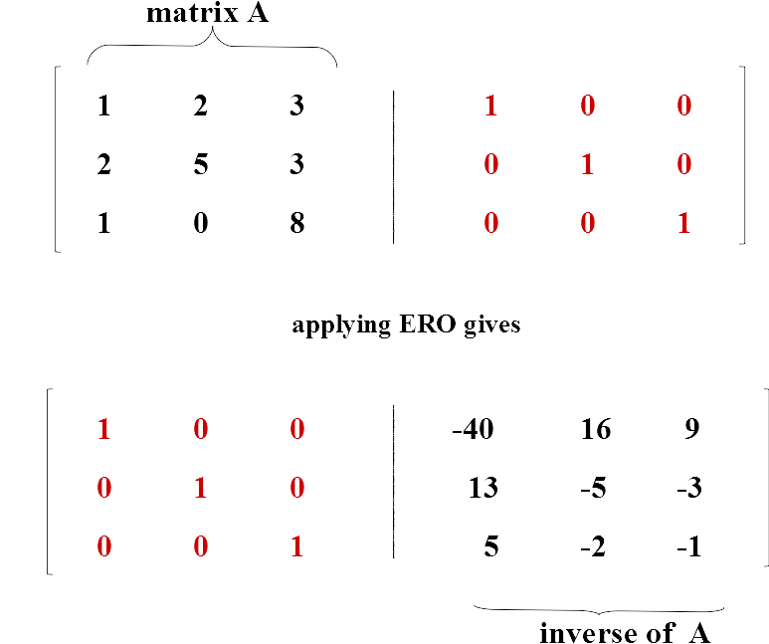
ERO

Slide 45


Slide 46
Intro Vectors
Notes:
Consider talking about:
Level 1
Level 2
Level 3

Slide 47
What will we learn?
Intro vectors
Vector operations

Slide 48
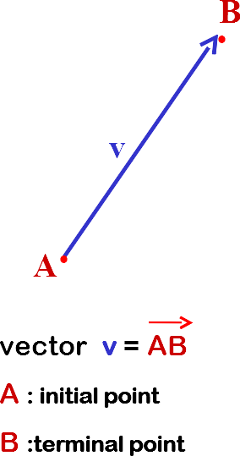
Intro Vectors

Slide 49
Vector operations
Addition
Subtraction
Norm
Dot Product
Cross Product

Slide 50
Norm of a vector:
( for the time being let “norm” mean “length” )
u = (u₁, u₂) ∈ R²
the norm of vector u = ||u|| = √(u₁² + u₂²)
v = (v₁, v₂, v₃) ∈ R³
the norm of vector u = ||u|| = √ (v₁² + v₂² + v₃²)
Unit Vector : a vector of norm 1 (one)

Slide 51
Dot product: u . v = scalar
Vectors u and v are 2-space (3-space) vectors,
with θ = angle between u and v
||u|| ||v|| cos θ if u ≠ 0 and v ≠ 0
u . v =
0 if u = 0 or v = 0
Note : u and v are perpendicular / orthogonal (θ = 90º & cos θ = 0)
iff u . v = 0

Slide 52
Dot product (Euclidean Inner Product):
u . v = scalar
u, v ∈ 2-space → u = (u₁, u₂), v = (v₁, v₂)
u, v ∈ 3-space → u = (u₁, u₂ , u₃), v = (v₁, v₂ , v₃)
then
2-space: u . v = u₁v₁ + u₂v₂
3-space: u . v = u₁v₁ + u₂v₂ + u₃v₃

Slide 53
Cross product :
vector u and vector v are both in 3-space
u = (u₁, u₂, u₃) v = (v₁, v₂, v₃)
then u × v = w where w is orthogonal to u and v
u × v = u₂ u₃ , – u₁ u₃ , u₁ u₂
v₂ v₃ v₁ v₃ v₁ v₂
w₁
w₂
w₃
w = u × v
The right-hand rule:
Direction of u × v
Direction of w
u
θ
v

Slide 54
Linear Transformations
Notes:
Consider talking about:
Level 1
Level 2
Level 3

Slide 55
Intro Linear Transformation
https://youtu.be/kYB8IZa5AuE?t=42s
https://youtu.be/kYB8IZa5AuE?t=2m34s
Notes:
Start 0:42
End 1:34
Start 2:34
End 3:47

Slide 56

$v = A∗u$
$v$ is a new vector
$A$ is a standard matrix
$u$ is a previous vector
https://youtu.be/kYB8IZa5AuE?t=8m
Notes:
End: 9.20

Slide 57
Euclidean n-spaces
Notes:
Consider talking about:
Level 1
Level 2
Level 3

Slide 58
n-space
The set of vectors with n components
{ … , v = (v1, v2, v3, v4, …, vn), ….. }
(v1, v2, v3, v4, …, vn) is called ordered n-tuple

Slide 59
Example
Your grade (100, 28, 49, 89, 90) quintuple
Weighting in % (20, 15, 15, 15, 35)
or (0.20, 0.15, 0.15, 0.15, 0.35)
Truck rental (4, 5, 3, 15, 20, 36, 21, 7)
Graphical Images (x, y, hue, saturation, brightness)

Slide 60
Operations
Addition
Subtraction
Norm
Dot Product

Slide 61
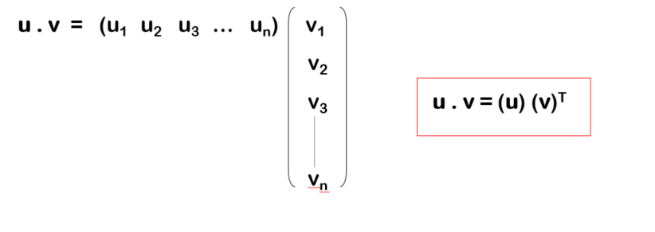
Norm
||v|| = √ (v₁² + v₂² + v₃² +… + v_{n}²)
Dot Product
u . v = u₁v₁ + u₂v₂ + u₃v₃ + … + u_{n}v_{n}

Slide 62
The End
???????????????

Slide 63
More on Linear Algebra
Linear Combination and Span
Basis and Dimension
Rank and Nullity
Orthonomal Bases
Least Squares Matrix
Eigenvalues and Eigenvectors
Diagonalization

Slide 64
Source
Video from 3Blue1Brown: s.id/linalg3blue1brown
Elementary Linear Algebra Book: https://warwick.ac.uk/fac/sci/maths/undergrad/ughandbook/content/ma106/elementary_linear_algebra_10th_edition.pdf

